Slide 1
Project Report
Project

Slide 2

Project Title
e-Transaction Interface

Slide 3
e-Transaction Interface
Submitted By :
MANJEET KUMAR
Roll NO-53
MCA , 3rd Year
Department of Computer Applications

Slide 4
Project Details
Project Title: e-Transaction Interface
Company Name: YASH INFOSOFT Pvt. Ltd
Guide
Er.Anil Kumar Singh.
Faculty Member
Department Of Computer Applications
A.N.College,Patna

Slide 5

Company Profile
Yash Infosoft offers a comprehensive range of software and IT solutions, including packaged applications for the School, College, Hospital, Logistic and Pharmacy, Manufacturing, and Retail & Distribution industries. In addition, it offers a broad range of software services such as Custom Software Development, Web designing and development, among others The Company’s Delivery Model provides for the best resources to be drawn from its vast talent pool all over India offer optimal solutions. Yash Infosoft integrates its products and services to create customized solutions to allow you to undertake technology-based business transformation that allows reorganization in line with today's dynamic digital business environment.

Slide 6

Company Profile Continue…
Our Services:
Enterprise Resource Planning
School Management System
College Management System
Hospital Management System
Logistic Administration Software
Library Administration Software
Web Based Solution
Search Engine Optimization

Slide 7

Our Technology Expertise lies in the following.
Java/j2ee
Microsoft Technologies
Testing
Mainframe
Data warehouse
Telecom
Embedded Systems, Net

Slide 8
Abstract
The e-Transaction Interface is the designed targeted at the future banking solution for the users.
who is having multiple bank accounts at the multiple banks.
This interface integrates all existing banks
And provides business solutions for both retail and corporate.

Slide 9
Overview
This system acts as a standard interface between the clients and all the banks, that register with the system and clients who maintains accounts in various banks don’t have to visit individual bank’s website to make money transactions instead he can directly log on to e-Transaction Interface and make any kind of request and get his work fulfilled and in the backend the system will take care of all the obligation required in order to carry on transaction smoothly

Slide 10
Goal
The main Vision of this project is to eliminate all the diversities amongst banks, which generally client faces at the time of any transaction.
By doing so Client will used to only one Systematic Standard way of banking and there by they will be at ease using this interface.
The kind of functionality it’s capable of providing also reveals the kind of banking facilities that a customer could get online.
Of course, the bank that implements this solution decides the features available to customers.

Slide 11
Scope
This system provides a Common User Interface for the customers to log on to any bank.
Here the user interface is Graphical User Interface.
This application is a Web based Application.
Being a web based application it doesn’t require any client side installation.
Any number of users can interact with the system simultaneously.
Eradicates the time consumed to learn how to use all the user interfaces of every bank in which a customer is having account.
The transactions are secure.

Slide 12
Modules
1) Banker Module
This module deals with the Accounts Pending, Pending Transfers, and Reports regarding transactions.
2) Customer Module
This module a customer can register him self to the system, customer can login into the system. A customer can add a new account, view the account information, Transfer amount, A customer can also see the Transaction Reports.
3) Admin Module
The admin module will be used by the administrator of the site, The admin can accept or reject the request from the banker, and The admin can accept or reject the request from the user. The request are in the form of bank registration, customer registration.

Slide 13

System Requirements Hardware
Pentium IV Processor.
256 MB RAM.
40GB Hard Disk space.
Ethernet card with an Internet and Internet zone.

Slide 14
System Requirements Software
Server Side:
Microsoft Windows 2000 Prof
Internet explorer 5.0 or above or Netscape navigator.
Oracle 9i or later versions.
JDK 1.4 or Later versions.
Apache Tomcat Web Server 4.0 or above.
TCP/IP Protocol suite.
Client Side:
Web Browser on Windows XP/towards

Slide 15
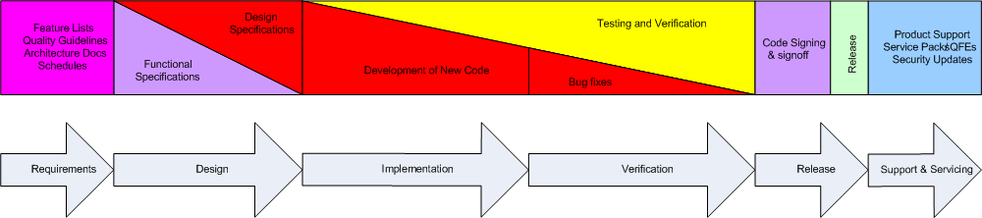
Model being exercised Baseline Process
It appears to suggest a "waterfall" development process, the process is in fact a spiral.
Requirements and design are often revisited during implementation, in response to changing market needs and to realities that arise during software implementation.

Slide 16
Designing :
Mapping system requirements to an abstract representation of a specific system implementation
Draw to meet the cost and performance constraints
Program Flow Chart
DFD
E-R Diagram
Class Diagram
Use Case Diagram
Sequence Diagram

Slide 17
DESIGN PHASE
In this design phase we design the system making use of study phase and the data flow diagrams.
We make use the general access methods for designing.
We consider the top down approach.
In the design phase we determine the entitle and their attributes and the relationships between the entities.
We do both logical and the physical design of the system.

Slide 18
DEVELOPMENT PHASE:
In the development phase we mostly do the coding part following the design of the system.
We follow modular programming for development and after development and after developing each and every module we do the unit testing followed by the integration testing.

Slide 19
IMPLEMENTATION PHASE
The last phase of the project is the implementation phase.
Quality assurance is the primary motive in this phase.
The quality assurance is the review of software products and related documentation for completeness, correctness, reliability and maintainability.
The testing strategies are of two types, the code testing and the specifications testing.
In the code testing we examining the logic of the program.
On the surface, code testing seems to be ideal methods for testing software, but not all software errors are uncovered.

Slide 20
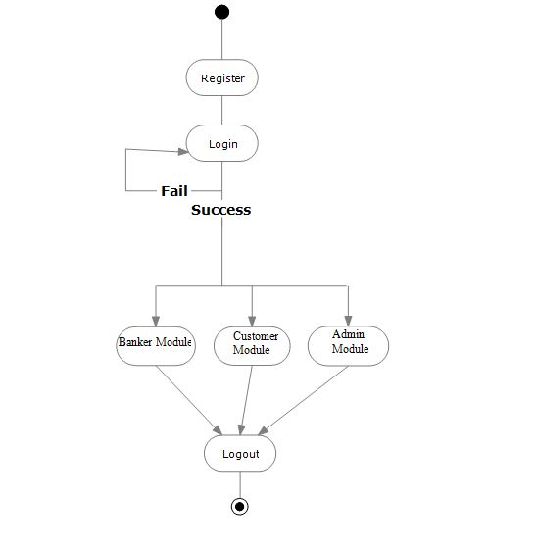
Program Flow Chart

Slide 21
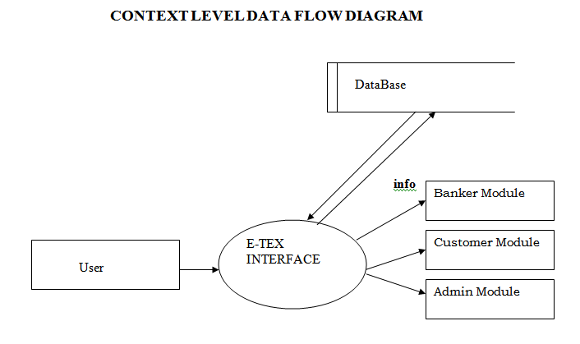
DFD
.

Slide 22
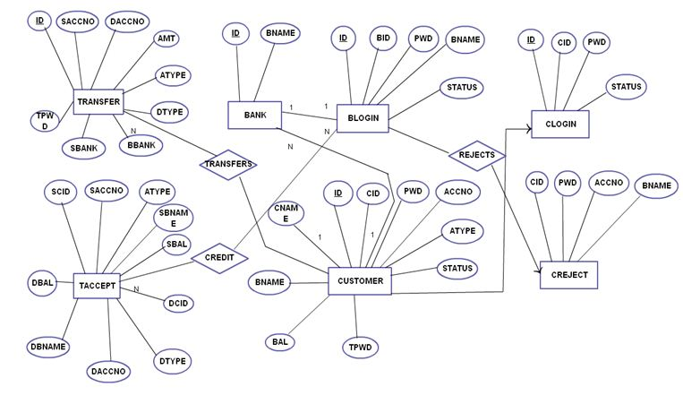
E-R Diagram

Slide 23
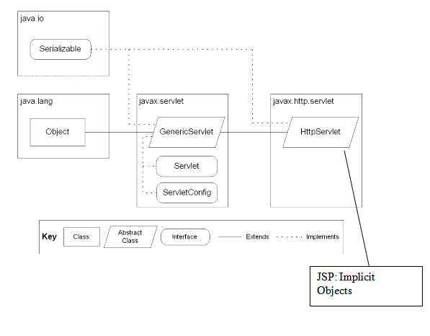
Class Diagram

Slide 24
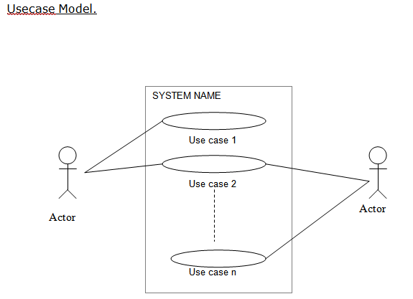
Use Case

Slide 25
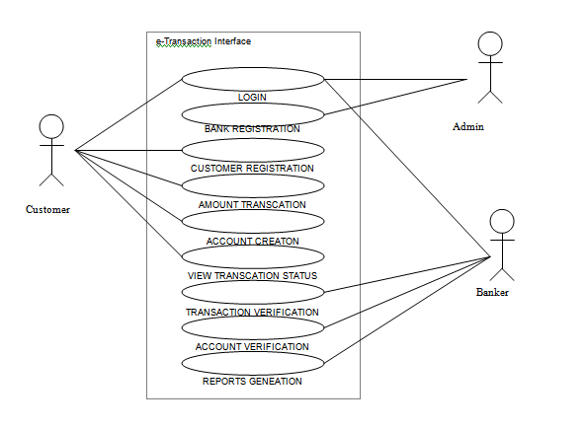
..

Slide 26
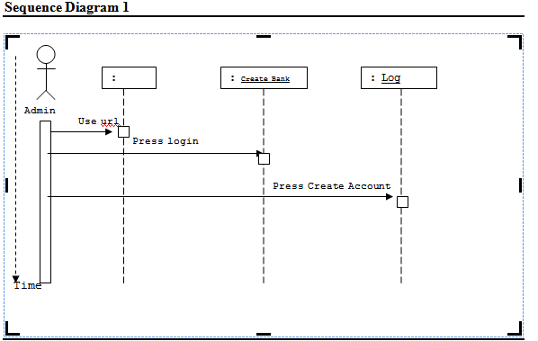
.
SEQUENCE DIAGRAMS
Sequence Diagram 1
.

Slide 27
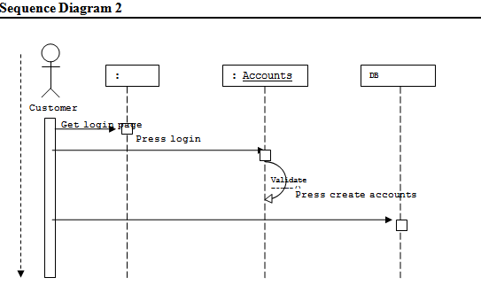
..

Slide 28
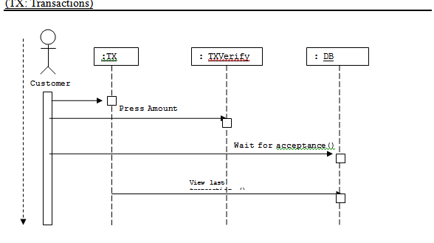
.

Slide 29
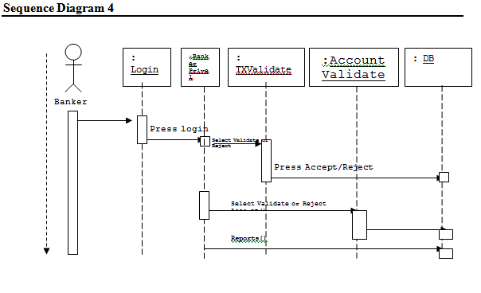
..

Slide 30
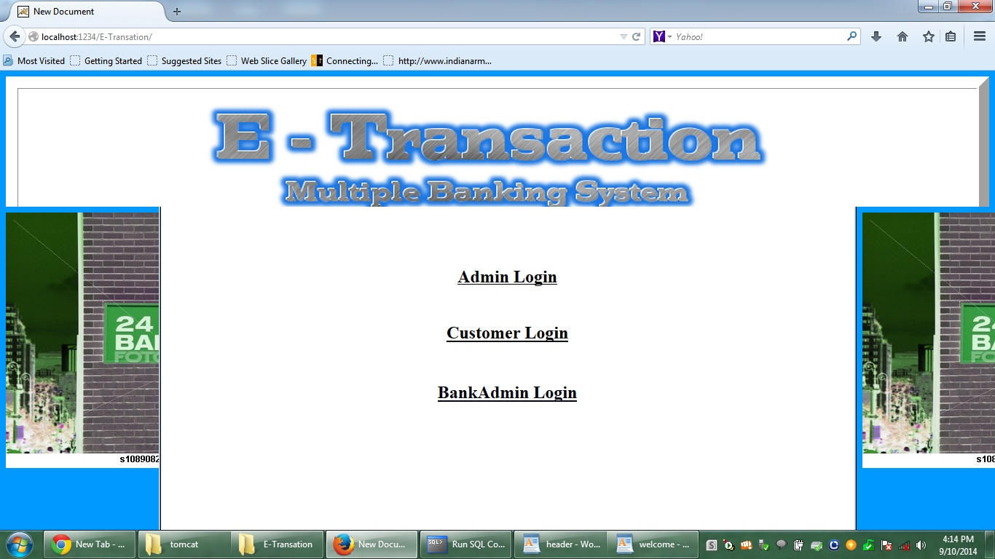
Screen

Slide 31
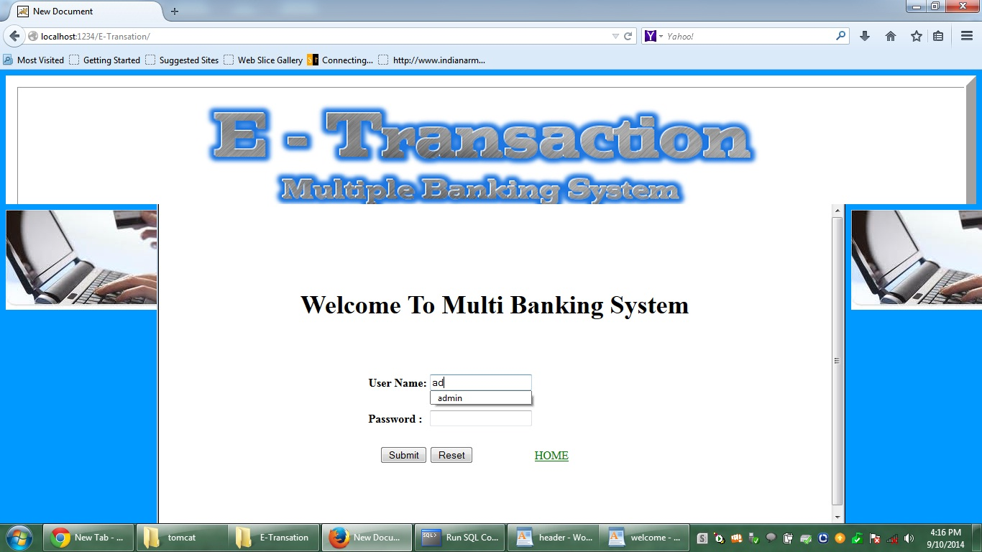

Slide 32
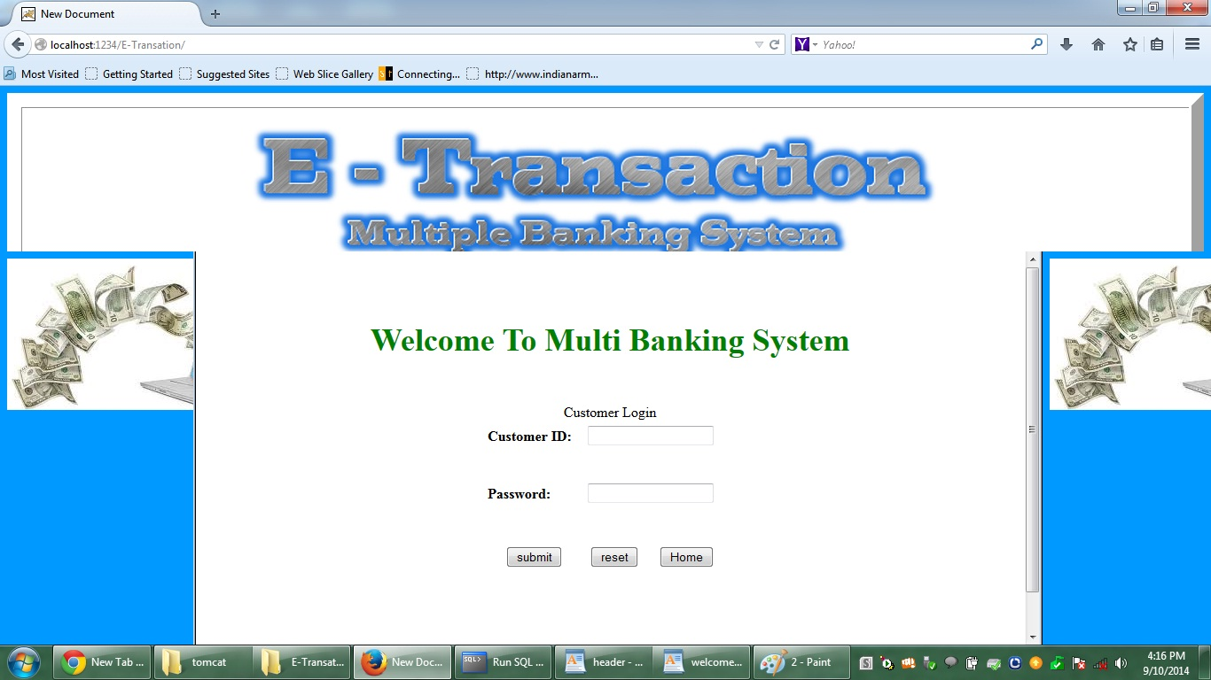

Slide 33
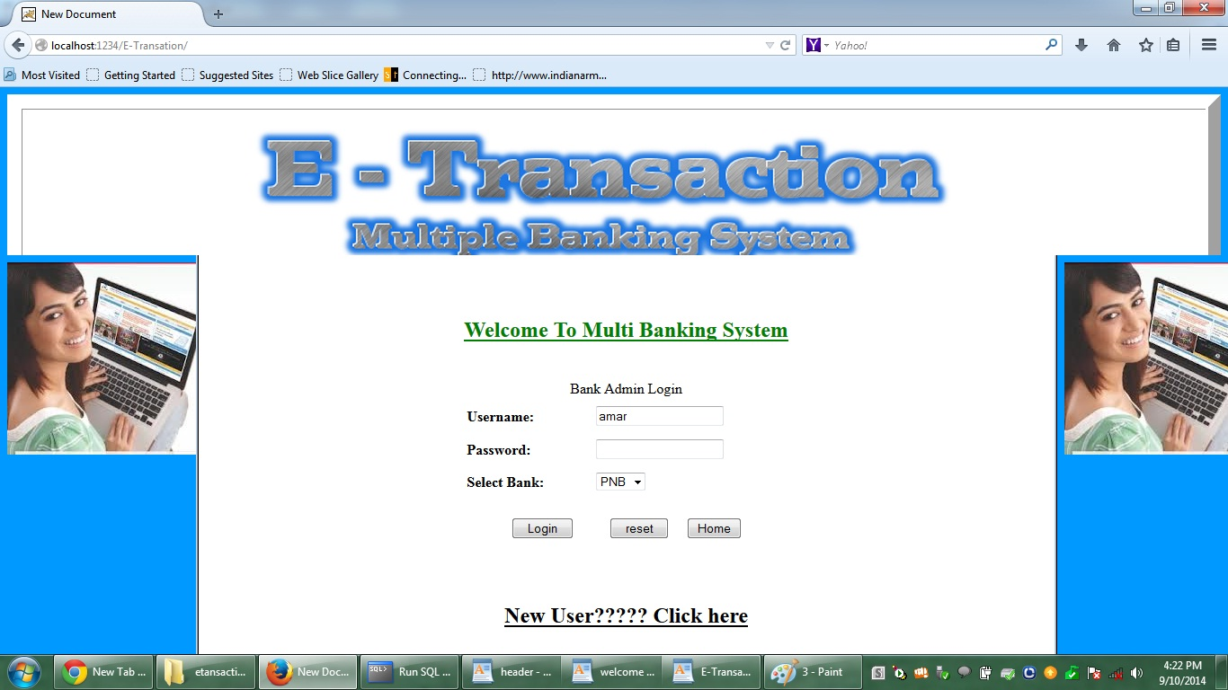

Slide 34
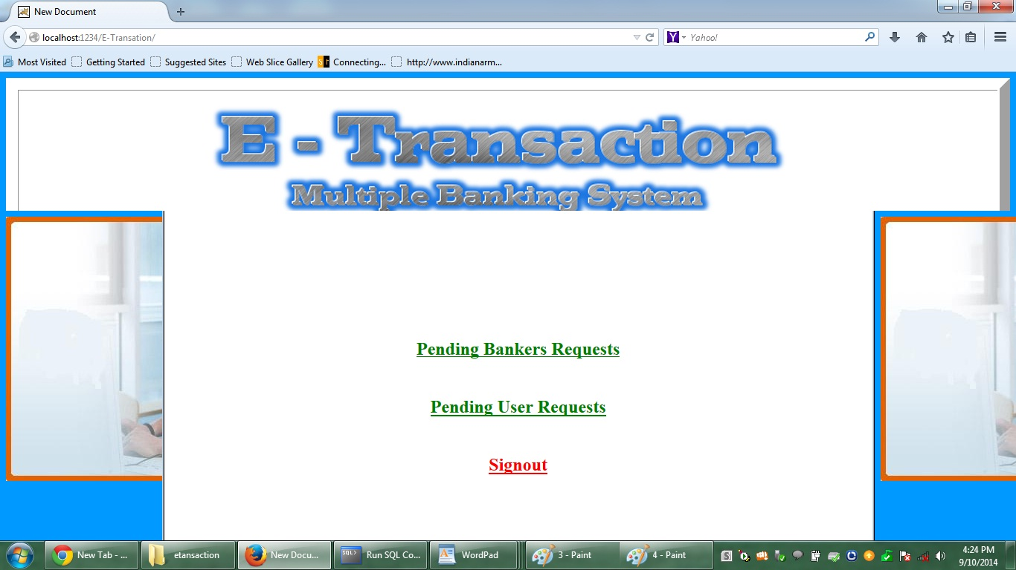

Slide 35
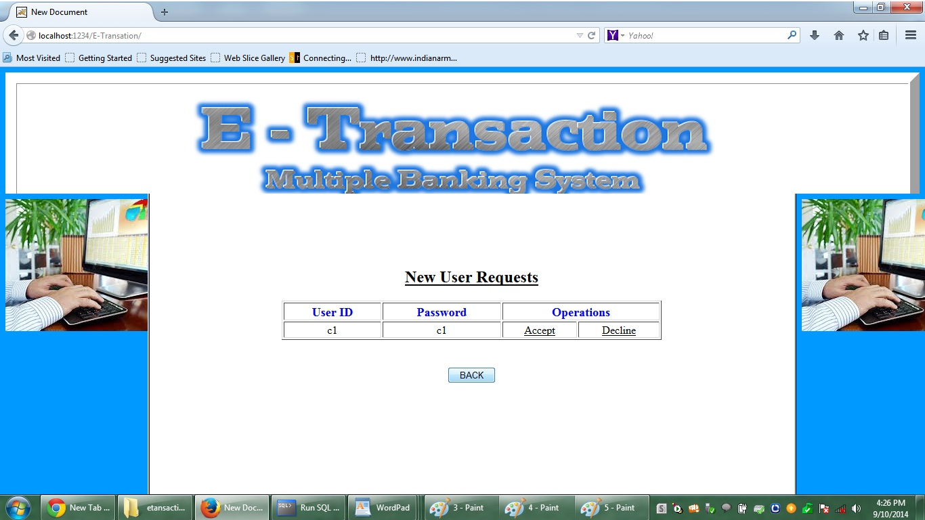

Slide 36
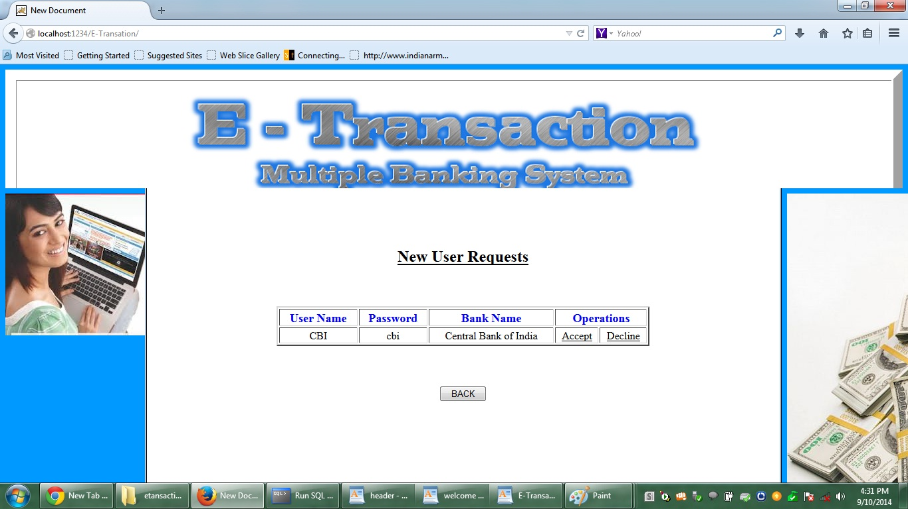

Slide 37
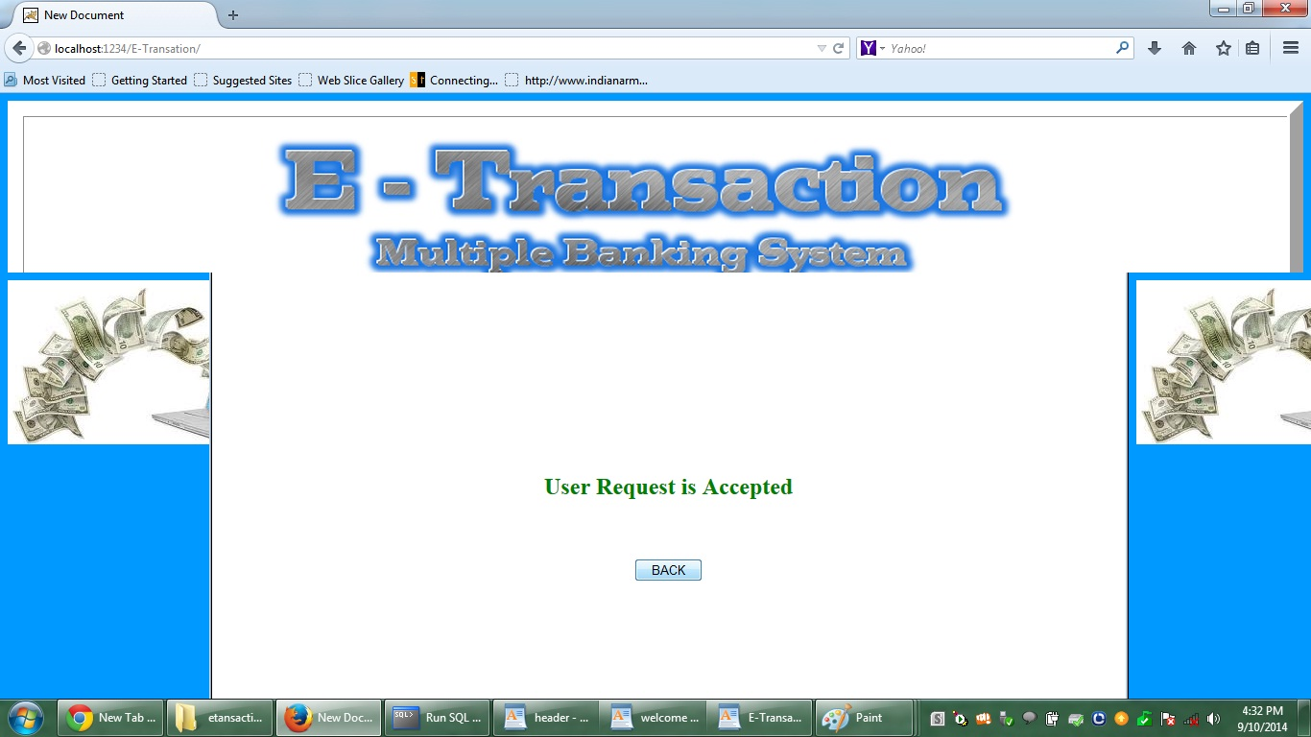

Slide 38
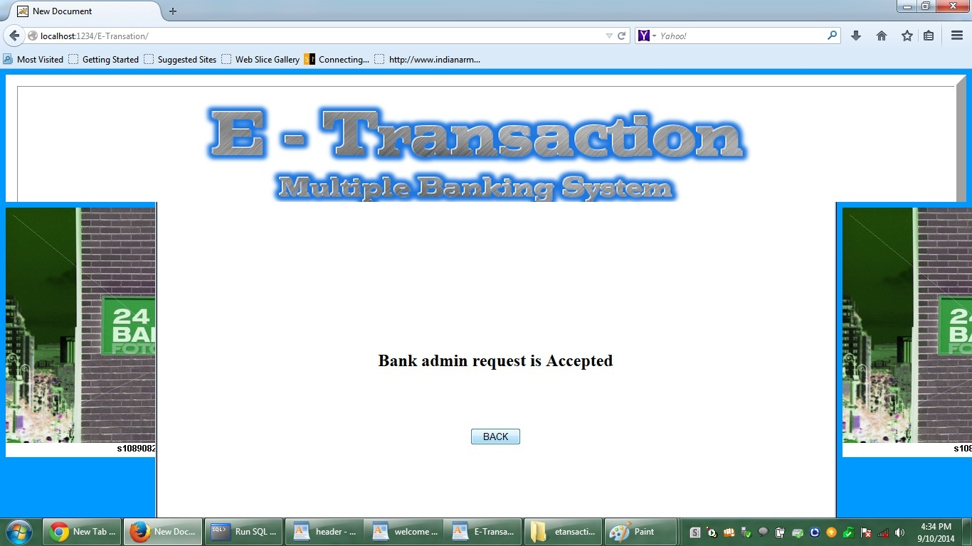

Slide 39
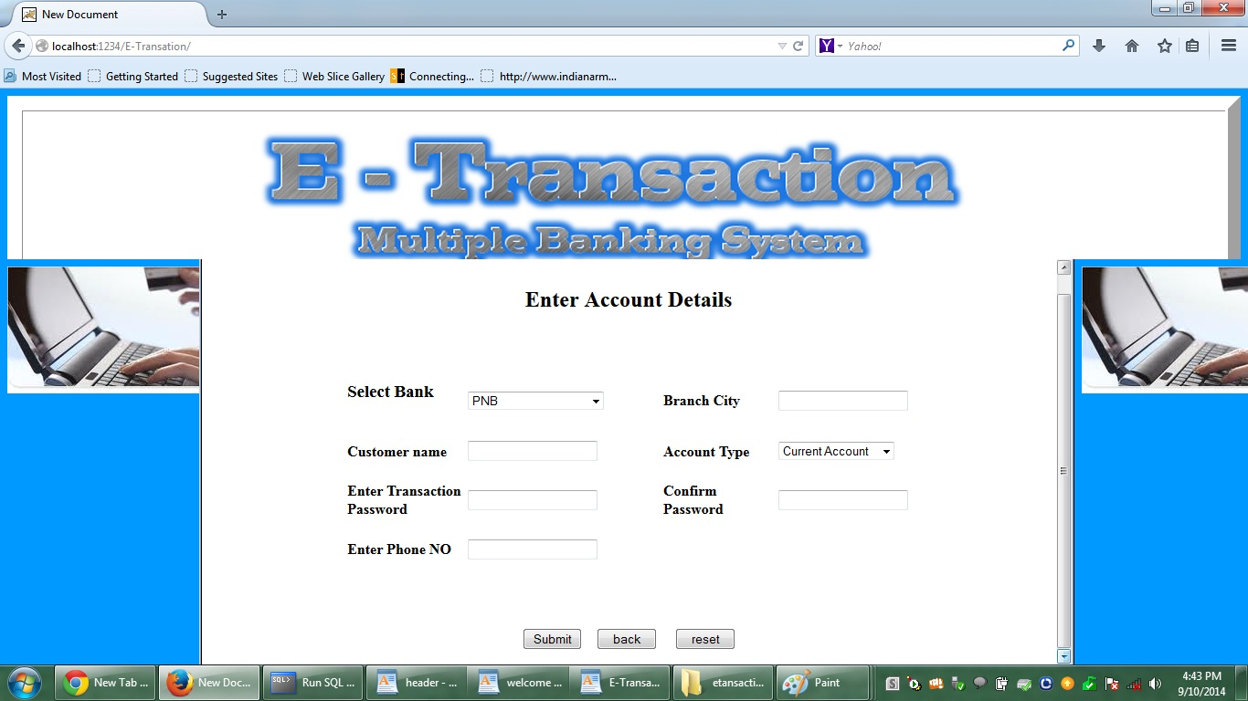

Slide 40
Database/Table/Normalization
Bank Table
Field Name | Data Type | Constraints | Description
ID | Number | Null | Login number
BNAME | Varchar2(100) | null | Name of Bank
Bank Login
Field Name | Data Type | Constraints | Description
ID | Number | Null | Login number
BID | Varchar2(100) | Null | ID of Bank
BNAME | Varchar2(100) | Null | Name of Bank
STATUS | Number | Null | Status of bank
PHONE | Number | Null | Contact No

Slide 41
TABLE Customer LOGIN
Field Name | Data Type | Constraints | Description
ID | Number | NULL | Customer ID
CID | Varchar2(100) | Primary Key | Unique
PWD | Varchar2(100) | Null | Password
STATUS | Number | Null | Status of A/C
PHONE | Varchar2(15) | Null | Contact No
Email | Varchar2(30) | Null | E-mail ID

Slide 42
TABLE Customer REJECT
Field Name | Data Type | Constraints | Description
CID | Varchar2(100) | Null | Customer Id
PWD | Varchar2(100) | Null | Password
ACCNO | Varchar2(100) | Null | A/C Number
BNAME | Varchar2(100) | Null | Name of Bank

Slide 43
TABLE CUSTOMER
Field Name | Data Type | Constraints | Description
ID | Varchar2(100) | Null | ID
CID | Varchar2(100) | Null | Customer ID
PWD | Varchar2(100) | Null | Password
ACCNO | Varchar2(100) | Not Null | Unique
ATYPE | Varchar2(100) | Null | Select a/c type
CNAME | Varchar2(100) | Null | Name of Customer
BNANE | Varchar2(100) | Null | Bank Name
BAL | Number | Null | Amount
TPWD | Varchar2(100) | Null | For security
STATUS | Number | Null | Accept/Reject
PHONE | Varchar2(15) |  | For inquary
City | Varchar2(100) | Null | Addr. of Customer

Slide 44
TABLE REJECT
Field Name | Data Type | Constraints | Description
CID | Varchar2(100) | Null | Customer Id
ACCNO | Varchar2(100) | Null | a/c Number
ATYPE | Varchar2(2100) | Null | Type of a/c
BNAME | Varchar2(100) | Null | Bank Name

Slide 45
TABLE TACCEPT
Field Name | Data Type | Constraints | Description
SCID | Varchar2(100) | Null | Src bnk ID
SACCNO | Varchar2(100) | Null | Name of src a/c No
ATYPE | Varchar2(100) | Null | A/C Type
SNAME | Varchar2(100) | Null | Src bank Name
SBAL | Number | Null | Balance
DCID | Varchar2(100) | Null | Desti. Cust ID
DACCNO | Varchar2(100) | Null | Desti A/C No
DTYPE | Varchar2(100) | Null | Desti A/C Type
DBNAME | Varchar2(100) | Null | Desti. Bank Name
DBAL | Number | Null | Desti. Bnk amount

Slide 46
TABLE TRANSFER
Field Name | Data Type | Constraints | Description
ID | Varchar2(100) | Null | Bank Id
SACCNO | Varchar2(100) | Null | Source A/C No
AMT | Number | Null | Amounts
ATYPE | Varchar2(2100) | Null | Type of a/c
DTYPE | Varchar2(100) | Null | Destination Bank
TPWD | Varchar2(100) | Null | Password for trns.
SBANK | Varchar2(100) | Null | Source Bank Name
DBANK | Varchar2(100) | Null | Desti. Bank Name
CID | Varchar2(20) | Null | Cust ID
SCID | Varchar2(30) | Null | Src cust. ID

Slide 47

Test case Design
Module Testing :- A Module, which is a collection of dependent components such as procedure and function, are tested in modules testing.
Unit Testing :- Unit testing was done in this project to uncover the errors that occurred at the time of development. Each module was tested with a set of predefined data. The interface between the modules is also tested to ensure proper information flow.
Integration Testing :- Modules are tested by itself, then it is immediately added to a group of already tested modules and the whole group is tested.
White Box Testing :- It is a testing in which in which the software tester has knowledge of the inner workings, structure and language of the software, or at least its purpose.
Black Box Testing:- It is testing the software without any knowledge of the inner workings, structure or language of the module being tested

Slide 48
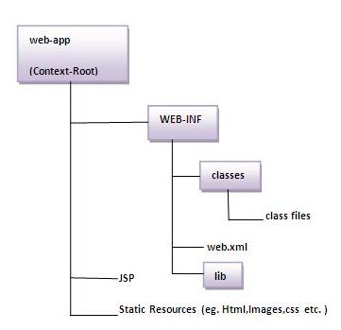
How to Run
http://localhost:portnumber/E-Transation

Slide 49
…
Thank YOU…!!!

